Slide 1
AN

Slide 2
Introduction
The purpose of this presentation is to present the findings of California house pricing project which I conducted using python.
My objective was to develop a model that could accurately predict the prices of houses in California based on a set of features such as the number as the longitude, latitude, total number of rooms and other factors.
Using my dataset, I performed explanatory data analysis, data cleaning and and feature engineering to prepare the data for the modelling.
I then used machine learning algorithms,including linear regression to train and evaluate several models.

Slide 3
DATASET
I will be using the California Housing Prices dataset, which contains information on the median house value, as well as other attributes such as income, population, and housing characteristics, for various blocks within California.
There are a total of 20640 instances in the dataset.
The target variable is the median house value which ranges from $14,999 to $500,001 .

Slide 4
Exploratory Data Analysis(EDA)
EDA is the process of analyzing the dataset to understand the relationship between the features and the target variable which is the price of a house in California
I learned that exploratory data analysis (EDA) is an essential step in any data analysis project and that it involves examining the data to identify patterns, trends, and anomalies that may be relevant to our analysis.
I used EDA so as to understand the data better and inform my subsequent analysis.

Slide 5
Data Cleaning
Before i begin my EDA, I need to clean the data to ensure it is ready for analysis.
Data cleaning involves removing duplicates, filling in missing values, and checking for outliers.
It is essential to perform data cleaning to ensure the accuracy and reliability of our analysis.
I then plotted my histogram using my dataset which presented all the numerical variables in my dataset.
From the histograms you can see that the median house value has some outliers since there are houses that are priced much higher.

Slide 6
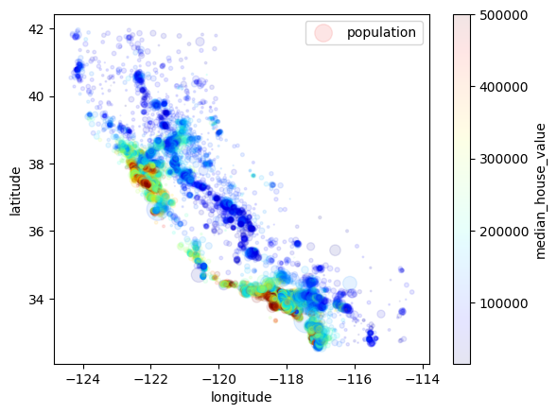
Relationship between house price and other features along the latitude and longitude
Next, I want to examine the relationship between median house price and other features along the latitude and longitude.
Since we have the geographical location data in terms of longitude and latitude we can plot the scatter graph.
Here is a scatter plot showing the relationship between these variables.

Slide 7
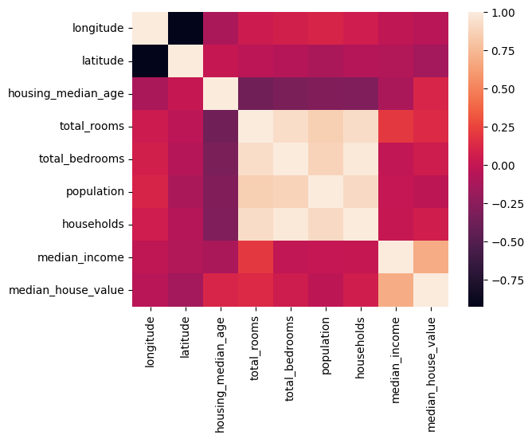
Relationship between house price and other variables
We can also examine the relationship between house price and other variables in the dataset, such as population, housing characteristics, and location.
Here is a heatmap of the correlation matrix between all variables.
As we can see, there are some variables that are strongly correlated with house price.

Slide 8
Conclusion
My project has revealed that the most important features for predicting house prices were the median income of the neighborhood, the total number of rooms, the latitude and longitude co-ordinates of the location.
Overall, this project provides valuable insights into the factors that influence house prices in California and demonstrates the effectiveness of machine learning techniques for predicting prices in the real estate market.

Slide 9
Model selection and evaluation
Using a dataset of over 20000 houses, I performed exploratory data analysis, data cleaning and feature engineering to prepare the data for modelling.
I then used machine language algorithms, including linear regression to train and evaluate several models.
A linear regression model can be built using the sklearn library once the data is visualized.

Slide 10
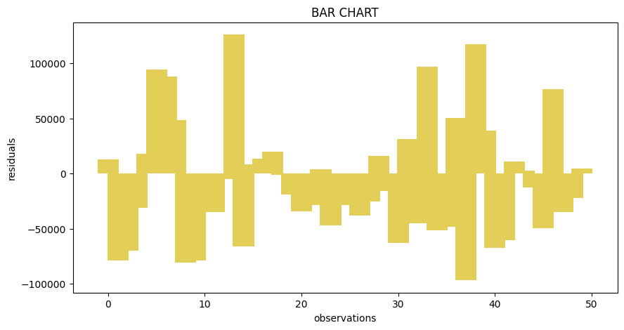
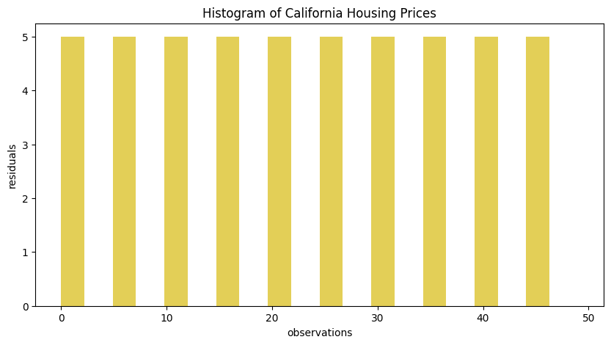
Visualizing the model
In order to provide a quick visual representation for the performance of my model I drew a bar graph as well as a histogram, allowing easy comparison between them.
From the bar graph I concluded that a good model is the one that has shorter bars because the taller the bar chart it is the further away you are from the actual values.
In order to display the model regressions I used the stats model library which is a special library for statistical models.

